Slide 1
Ruby Training: Methods
Matthew Eakin, Manager
Managed Testing Practice
Sogeti, USA
Matthew.Eakin@us.sogeti.com

Slide 2
Agenda
Note: this presentation is the 1st of a three part series (Methods, Variables, Class Objects).
Creating a method
Calling a method
Passing Parameters to methods

Slide 3
Before we get started
For tonight’s example we are going to use the following Example:
Given a new family moves in next door
When I greet them
Then they will greet me back
Go ahead and create a new Project: “Neighbors”
Go ahead and create a new file: “neighbors.rb”

Slide 4
Creating a Method
Definition: A method is a named block of parameterized code associated with one or more objects
Defined with the “def” keyword
Can take parameters
Ends with the “end” keyword
Must be initialized BEFORE you call it
Syntax:
def <name>(parameters)
end

Slide 5
Naming a Method
Method names may (but are not required to) end with:
an equals sign “=” – signifies that the method is a setter that can be invoked using assignment syntax
a question mark “?” – any method whose name ends with a question mark returns a value that answers the question posed by the method invocation
example: The empty? method of an array returns true if the array has no elements
an exclamation point “!” – often methods that end with an exclamation mark are mutators, which alter the internal state of an object
example: The sort! method of an array sorts the array elements

Slide 6
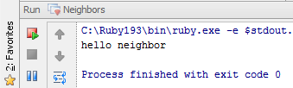
Calling the method
To invoke a method you need to call :
the method name
the object on which it is to be invoked (this is optional), and
zero or more argument values that are assigned to the named method parameters
Syntax:
(<object>).<method name>(parameters)
Write this code and Run Will get the following results
def hello_neighbor
puts "hello neighbor"
end
hello_neighbor

Slide 7
What value is the method returning?
The method will return the last expression evaluated in the method
Example:
#will return “Ohio”
def value_of_state
“Ohio”
end
You can use the “return” function to force a return
Example:
def value_of_state(state)
case state
when “OH” return “Ohio”
when “MI” return “Michigan”
end

Slide 8
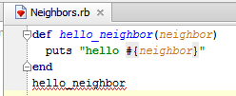
Passing Parameters
Methods in Ruby can accept Parameters
Syntax:
def <name>(<parameter>)
<code>
end
Update the method as follows:
def hello_neighbor(neighbor)
puts "hello #{neighbor}"
end
But wait, we now have a problem in our method call…

Slide 9
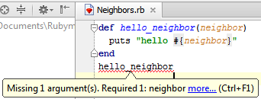
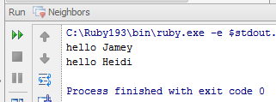
Once you change a method, you must change the call
Once you changed the method you should see the following errors
This is because when we created the method it did not need any values sent to it
Now it does
The fix is to simply add the parameter to the call
Update the code and run Will get the following results:
def hello_neighbor(neighbor)
puts "hello #{neighbor}"
end
hello_neighbor("Jamey")
hello_neighbor("Heidi")

Slide 10
Default parameters
Ruby allows you to place default values in the definition of a method
This allows you to pass fewer parameters
In the below example, the login fuction can take two parameters (user_name and password) or you could pass only one (user_name)
def login(user_name, password=‘abc_123’)
<code to log user into system>
end
Both of these calls will work:
login(‘Matt’, ‘123_abc’)
login(‘Matt’)

Slide 11
Passing a variable number of values to a method
Ruby allows you to pass a variable number of values to a single parameter
To access the values you need to use the “each” method:
Syntax:
def method( *args )
args.each { |string| <code>}
end
Examples: Can be called using:
def states( *state ) states(“OH”, “MI”, “KY”)
state.each {|names| puts names} states (“CA”)
end

Slide 12
Thank you

